Slide 1
Implementing GP Regression for Quantum Phase Transitions
Jeffrey Wei

Slide 2
Creating Figure 4: Predicting the order parameter m0

Slide 3
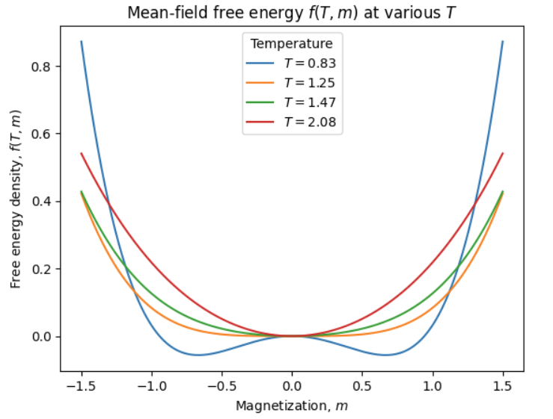
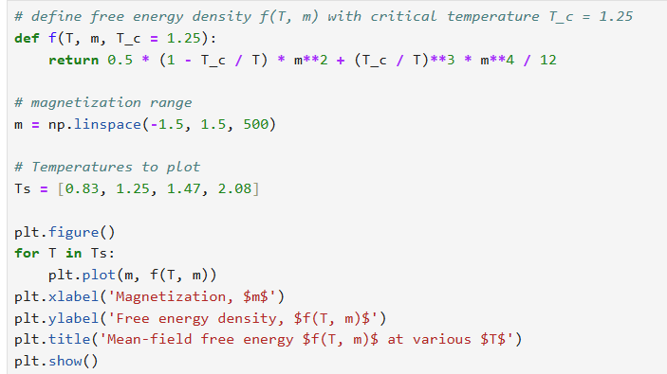
Plotting f(T, m)

Slide 4
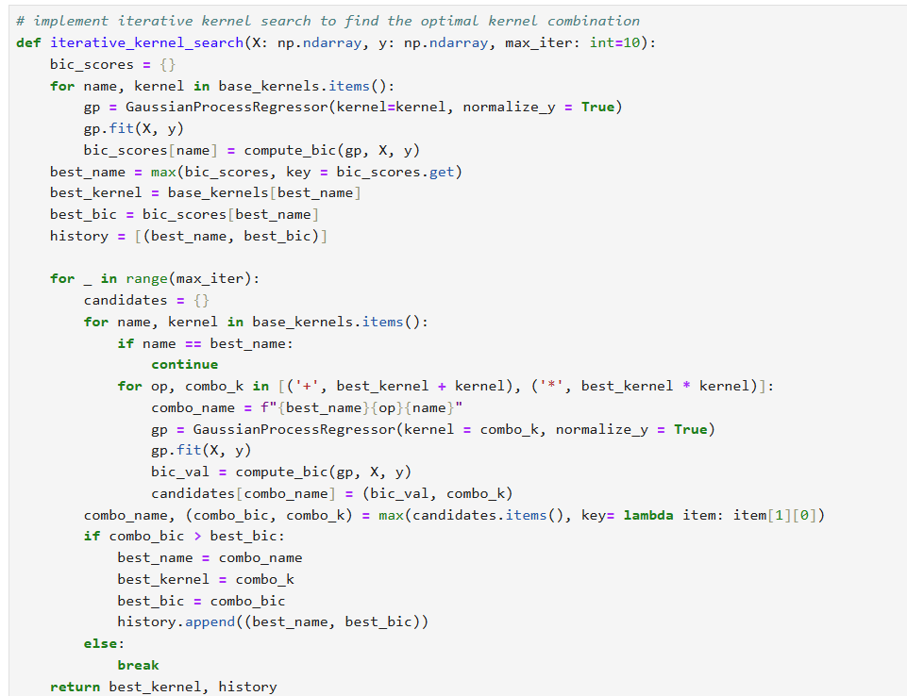
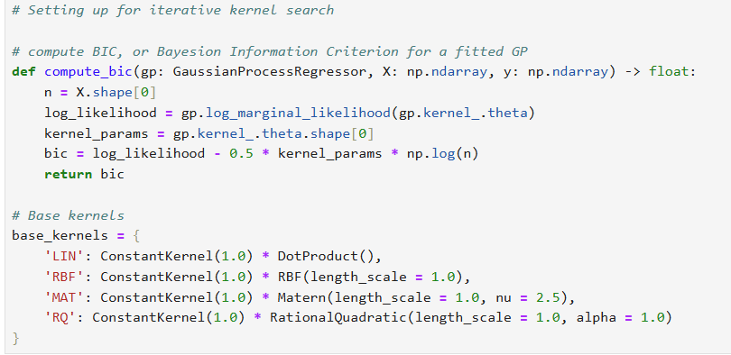
Implementing Iterative Kernel Search

Slide 5
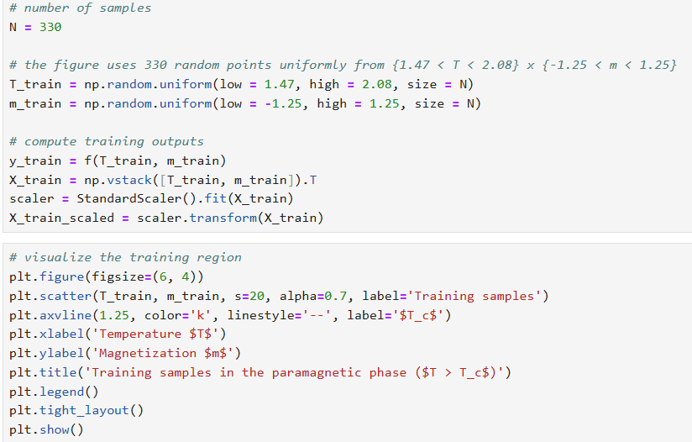
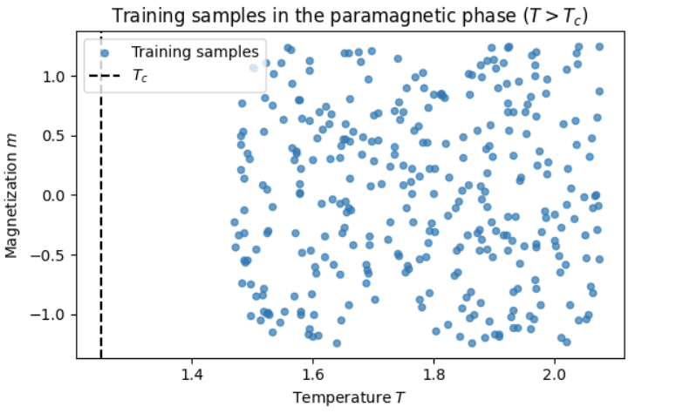
Visualizing Training Space: 330 Points in Paramagnetic Phase

Slide 6
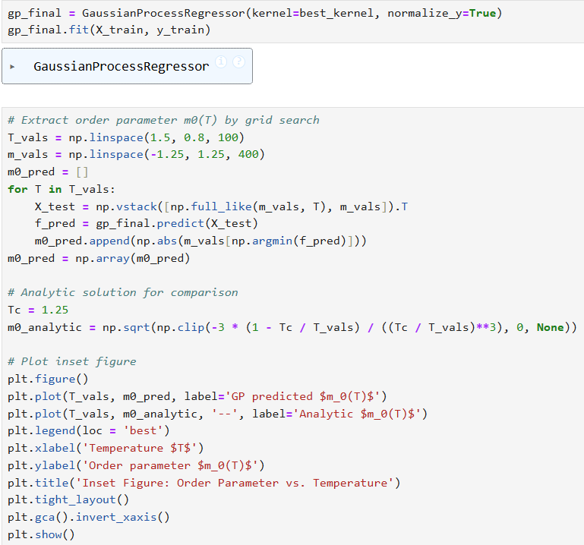
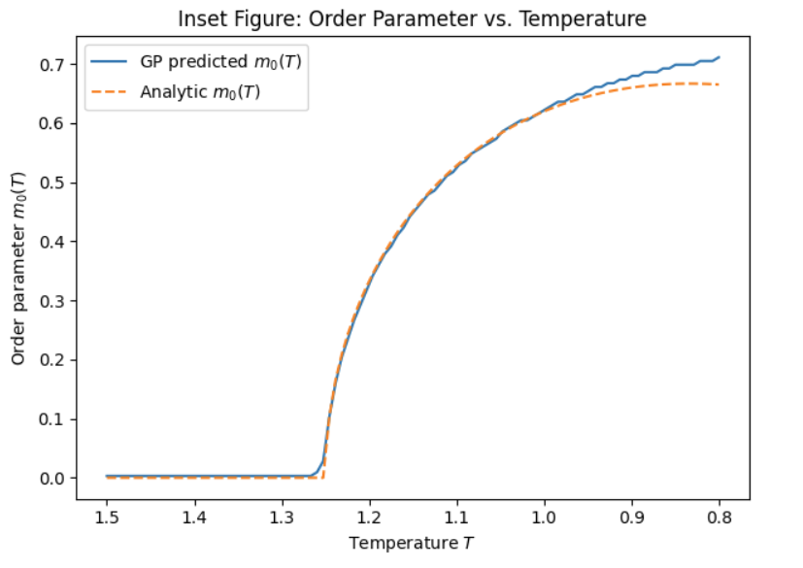
Order Parameter vs Temperature

Slide 7
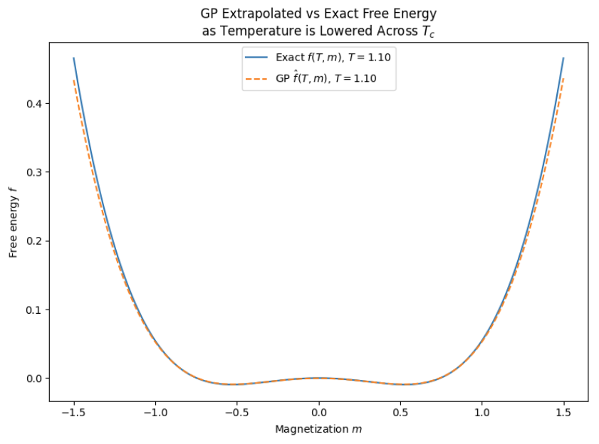
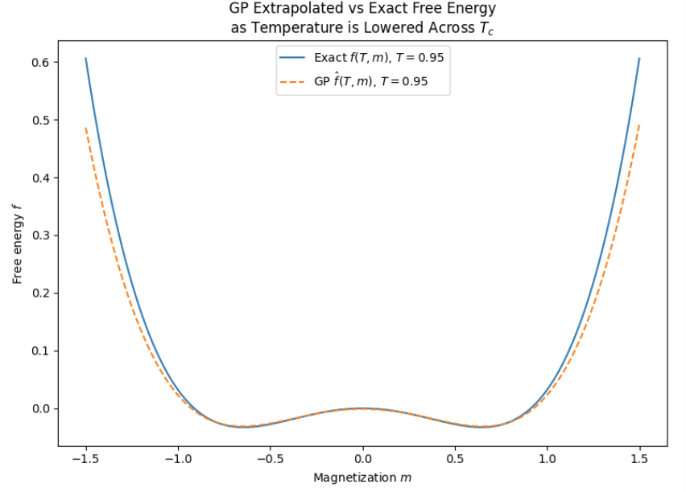
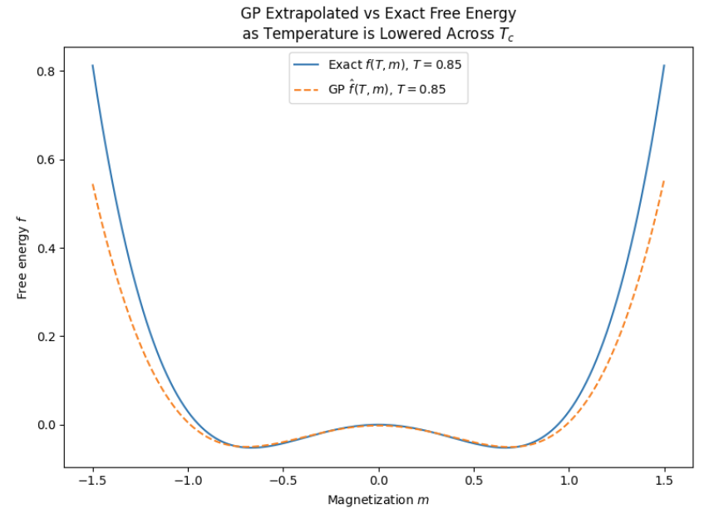
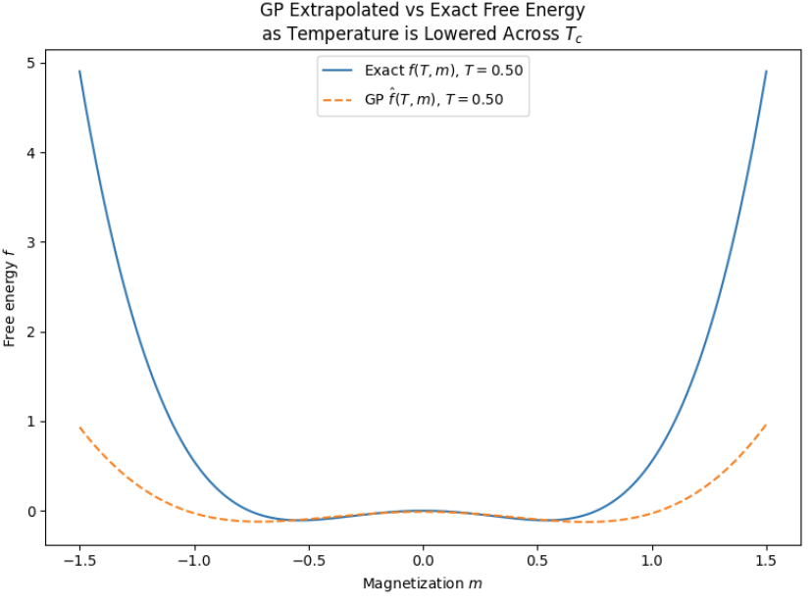
Accuracy of Extrapolated Mean Free Energy

Slide 8
Accuracy of Extrapolated Mean Free Energy
As T decreases, the extrapolated mean free energy becomes less accurate
This makes sense since GP is trained on T > T_c, so as we deviate further away from trained region the accuracy decreases
From -1.0 < m < 1.0, the prediction is consistently accurate without regard to temperature

